Slide 1



Share your photos to
the conference album!
#EMPOWERED2024

Slide 3
GOapply - Advanced Building Techniques
GOapply - Advanced Building Techniques
GOapply ADVANCED BUILDING TECHNIQUES
PRESENTED BY
Joe McCray | Technical Services Consultant
Zoey Fife | Support Tech Tier III

Slide 4

Key Features and Benefits
Expressions: The Foundation of Dynamic Surveys
Conditional Logic: Personalize the Survey Experience
Matrix Mapping: Efficiently Collect Structured Data
And More…
GOapply DEEP DIVE
BEYOND THE BASICS FOR INTERACTIVE AND PERSONALIZED OPPORTUNITIES

Slide 5
KEY FEATURES AND BENEFITS: EXPRESSIONS
Feature | Example | Benefit
Expressions can be used to calculate scores, totals, or other values based on applicant responses. | You can calculate total budget fields from multiple matrices to calculate budgets over a few years or grant cycles. That can be the sum or averages over the years. | This saves time for both applicants (who don't have to manually calculate values) and reviewers (who can quickly assess eligibility and merit based on automatically generated metrices).

Slide 6
KEY FEATURES AND BENEFITS: CONDITIONAL LOGIC
Feature | Example | Benefit
Conditional logic allows you to dynamically show or hide questions based on previous responses. | If an applicant indicates they are a first-generation college student, you can present them with specific questions about their background and aspirations. | This creates a more tailored experience for applicants, increasing engagement and providing relevant information for reviewers.

Slide 7
KEY FEATURES AND BENEFITS: MATRICES
Feature | Example | Benefit
Matrix questions present multiple related questions in a compact, grid-like format. | Applicants can quickly answer a series of questions that share the same response options (e.g., rating scales, Likert scales, multiple-choice). | This significantly reduces the time and effort required for applicants to complete the application, leading to higher completion rates and a more positive user experience.

Slide 8
EXPRESSIONS: THE FOUNDATION OF DYNAMIC OPPORTUNITIES
Learn how to create Opportunities that calculate scores, show/hide questions, and dynamically adjust content based on user responses.

Slide 9
WHAT ARE Goapply EXPRESSIONS?
Definition: Snippets of information that evaluate and return values within your survey
Purpose: Make your surveys dynamic and interactive
Key Components:
    Operators – equal (==), not equal (!=), Greater than or equal to (>=), +, -,
    Functions – Named blocks of code designed to perform specific tasks. {question11-total.GrantTotals}
    Variables – Named containers that store data (values) within a program. age = 25, applied Previously = True

Slide 10
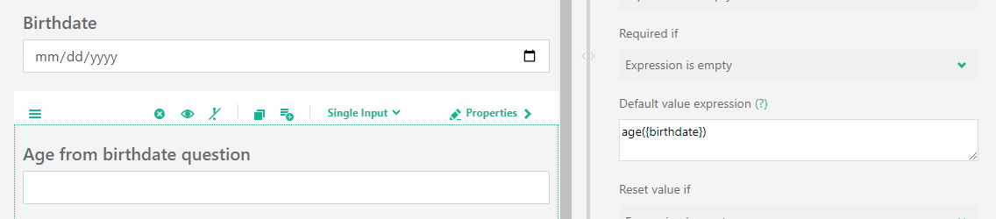
WHAT ARE Goapply FUNCTIONS?
Definition: Named blocks of code designed to perform specific tasks
    Example: age({birthdate})

Slide 11
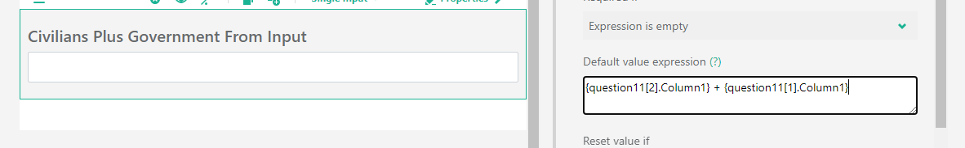
WHAT ARE Goapply OPERATORS?
Definition: Operators are special symbols or keywords used to perform operations on values within expressions.
  Operators – equal (==), not equal (!=), Greater than or equal to (>=), +, -

Slide 12
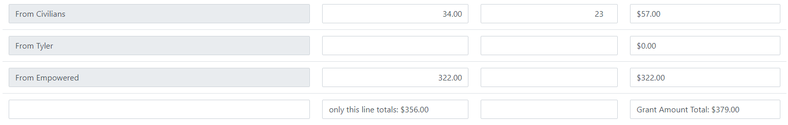
WHAT ARE Goapply VARIABLES?
What they are: Named containers that store data (values) within a program.
  Examples: age = 25, applied Previously = True

Slide 13
CONDITIONAL LOGIC: PERSONALIZE YOUR SURVEY FLOW
Take your applications to the next level with conditional logic, the akoyaGO feature that lets you dynamically control the flow of your questionnaire based on user responses.

Slide 14
COMMON USES OF CONDITIONAL LOGIC
Examples of Common Conditional Logic:
Visible if
Enable if
Required if

Slide 15
COMMON USES OF CONDITIONAL LOGIC
Examples of Operators in Conditional Logic:
Is empty
Is not empty
Equals
Not equals
Any of
Contains
Greater
Less

Slide 16
DON'T GET LOST IN THE MATRIX: akoyaGO MAPPING MADE EASY
Efficiently Collect Structured Data

Slide 17
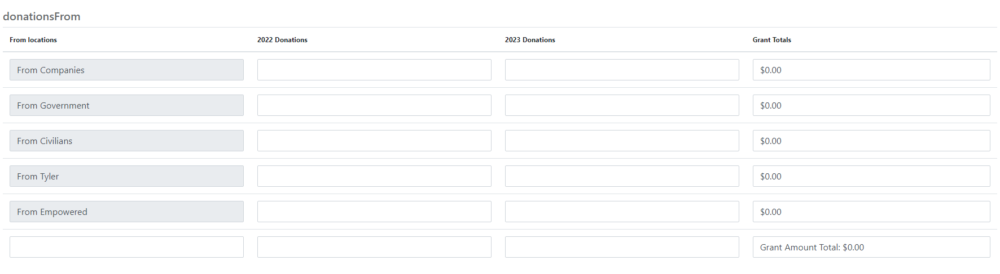
COMMON USES OF CONDITIONAL LOGIC
Dynamic Matrix: | {dynamic matrix name[row index].column name}
 | {donationsFrom[1].2022Donations}
 | {donationsFrom[2].2022Donations} + {donationsFrom[1].C2022Donations}
*rows begin with 0

Slide 18
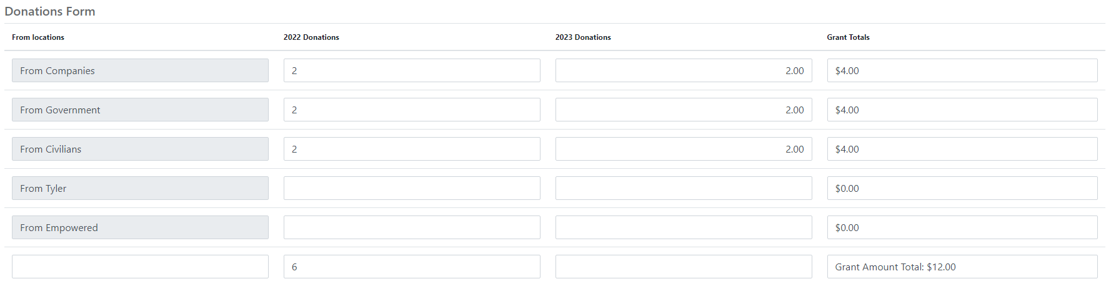
COMMON USES OF CONDITIONAL LOGIC
Dynamic Matrix Totals: | {question name-total.column name}
 | {donationsFrom-total.GrantTotals}
*rows begin with 0

Slide 19
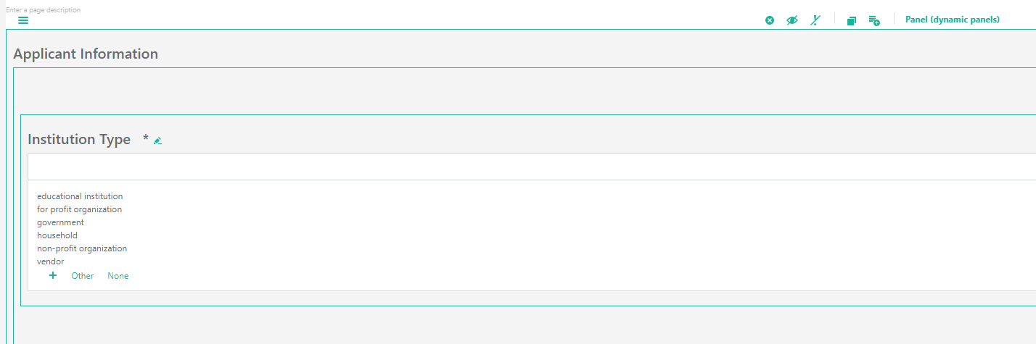
COMMON USES OF CONDITIONAL LOGIC
Dynamic Panels: | {parent Panel[0].question name}
 | {applicantInformation[0].institutionType}

Slide 20
SMART APPLICATIONS WITH akoyaGO
Revisiting what we’ve just learned!

Slide 21
NAVIGATING THE MULTI-SITE LANDSCAPE: A PRACTICAL GUIDE

Slide 22
MULTI-SITE SETUP
Why: geographic affiliates, unique branding, different use cases, scholarships vs. awards.
How:
  Contact akoyaGO support so we can update our records
  Create a 2nd (or 3rd) GOapply Settings record with your new site details
  Create applications and phases and use the new GOapply settings

Slide 23
REFERENCES FOR FUTURE USES
The awesome summary for you!

Slide 24
COMMON EXPRESSIONS
currentDate() – Gives you the current date
age({date field name}) – Calculates an age based on the date entered in the date field
today(enter the number here/use – to subtract days) – This will take today’s date and you can add days to it.
{question name} – This is the most common format for grabbing information or making simple expressions
Iif({question name} + {question name} > 20, ‘High, ‘Low’) – An advanced way to display information based on question names.

Slide 25
MATRIX EXPRESSIONS
Dynamic Matrix: | {dynamic matrix name[row index].column name}
Dynamic Matrix Totals: | {question name-total.column name}
Dynamic Panels: | {parent Panel[0].question name}

Slide 26
Presented By
Joe McCray
Technical Services Consultant
Zoey Fife
Support Tech Tier III
THANK YOU

