Slide 1



Share your photos to
the conference album!
#EMPOWERED2024

Slide 3
CHANGE MANAGEMENT & PROCESS REVIEW
PRESENTED BY
Ann Puckett | Director of IT | Grand Rapids Community Foundation
Mark Montoya | President

Slide 4

What is Change Management?
The Change Curve
Grand Rapids CF & Managing Change
Interactive Session
Q&A
AGENDA

Slide 5
WHAT IS CHANGE MANAGEMENT?
Helps you or your organization transition from a current state(s) to desired future state(s) smoothly and effectively.
Minimizes Resistance
Ensures Alignment
Enhances Adaptability
Optimizes Results

Slide 6
CHALLENGES CHANGE MANAGEMENT
Resistance to Change: Employee resistance due to fear of the unknown or perceived loss.
Poor Communication: Ineffective communication leading to misunderstandings.
Lack of Leadership Support: Insufficient support from top management.
Resource Constraints: Limited budget or inadequate resources.

Slide 7
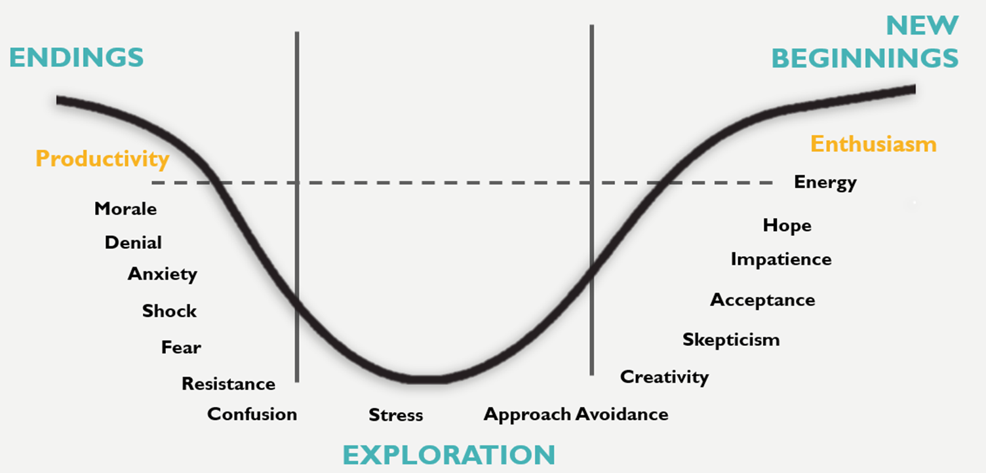
THE BRIDGES CHANGE CURVE

Slide 8
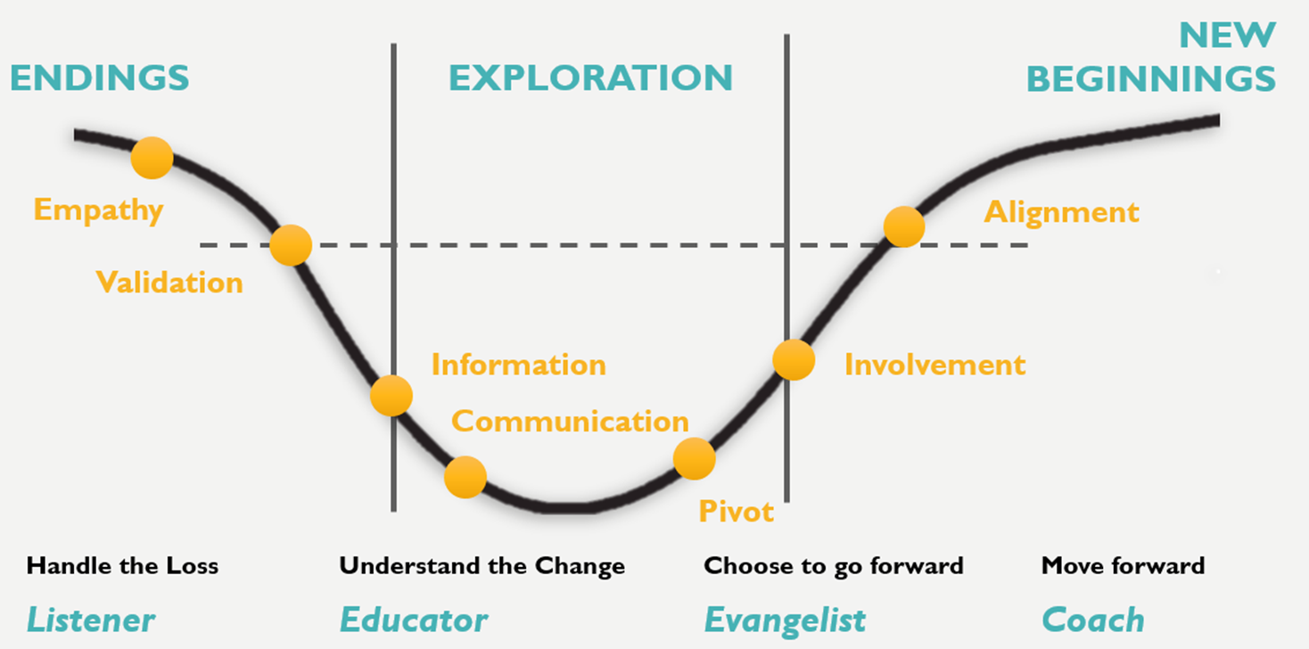
THE BRIDGES CHANGE CURVE

Slide 9

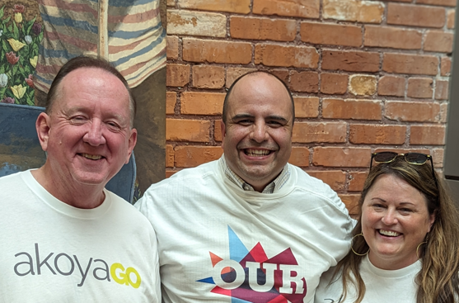
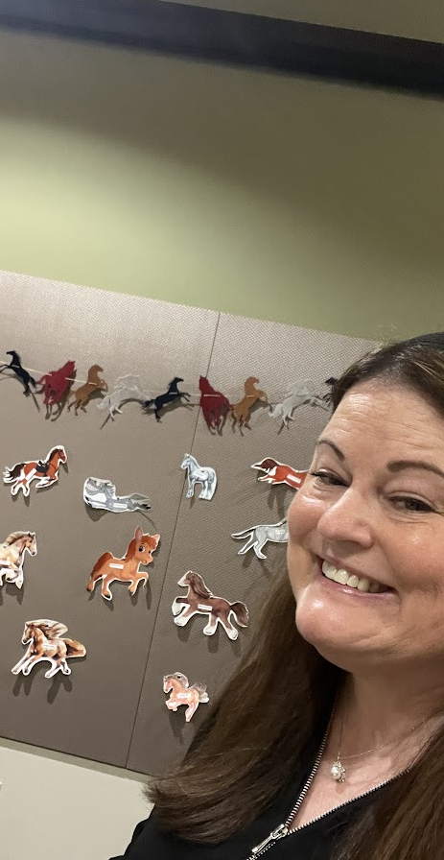
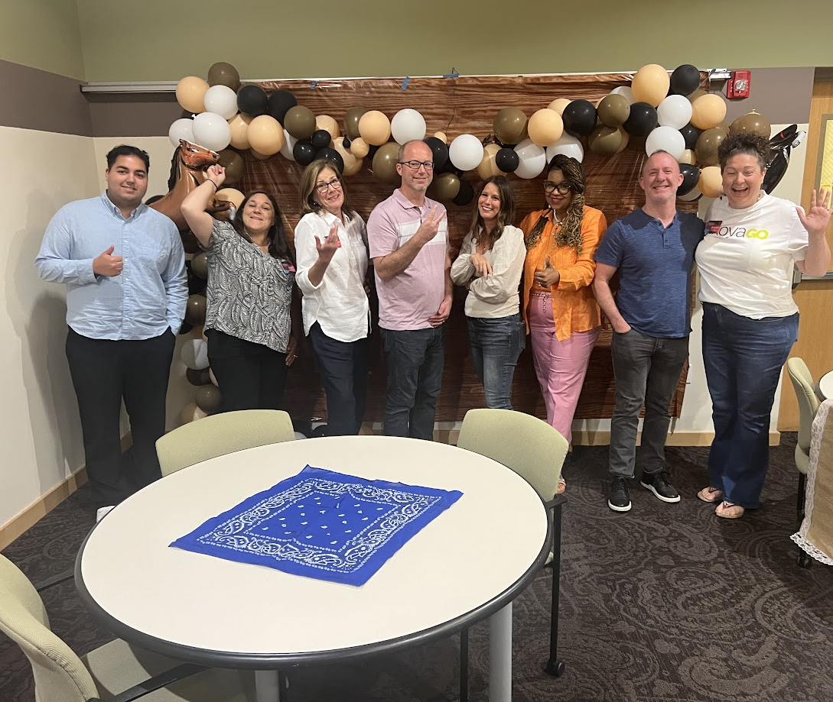

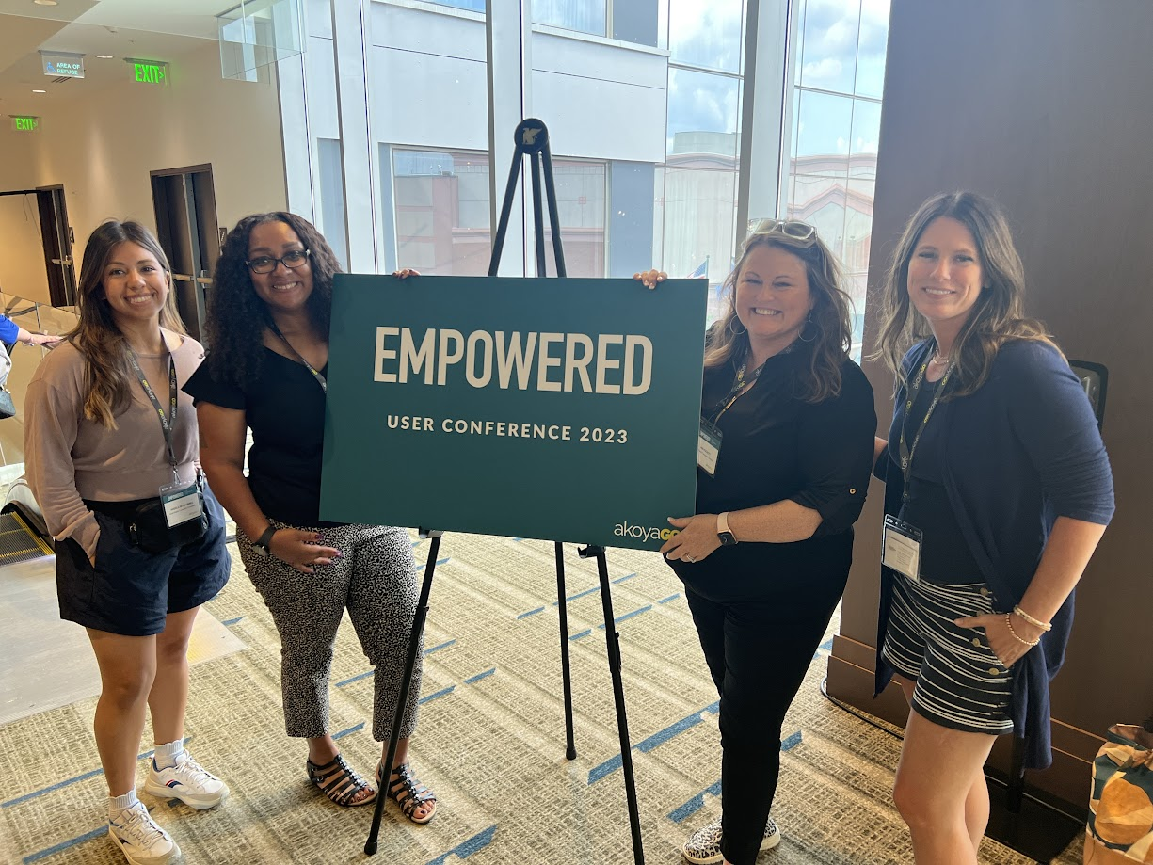
GRAND RAPIDS COMMUNITY FOUNDATION
Senior Leadership Support
Organization-wide effort
Champions of Change
Training – training - training

Slide 10
PROCESS IMPROVEMENT
Technology is not always the answer…
Focus on the problem first
Don’t add new tech to bad processes

Slide 11
INTERACTIVE SESSION – 20 MINUTES
Challenge: Pick a process to review – Suggest using a process that another CF is struggling currently with
Pick a scribe
Pick your brains! Thought-provoking questions to ask:
      Is this way it’s always been done?
      How many people are “touching” the process? (less is better)
      Are you checking the checker?

Slide 12
PRESENTED BY
Ann Puckett
Director of IT
Grand Rapids
Community Foundation
APuckett@grfoundation.org
Mark Montoya
President
Mark@akoyago.com
THANK YOU

