Slide 1



Share your photos to
the conference album!
#EMPOWERED2024

Slide 3
VISUALIZING AND REPORTING FINANCIALS IN BUSINESS CENTRAL
PRESENTED BY
Meghan Davignon | Director of Product

Slide 4

FINANCIAL REPORTS
Customizing Financial Reports

Slide 5
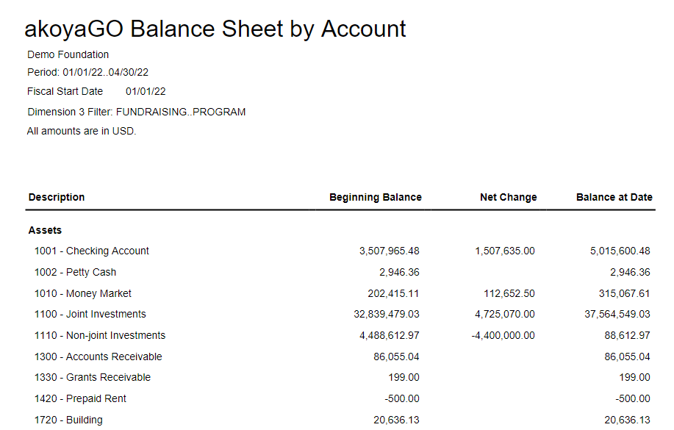
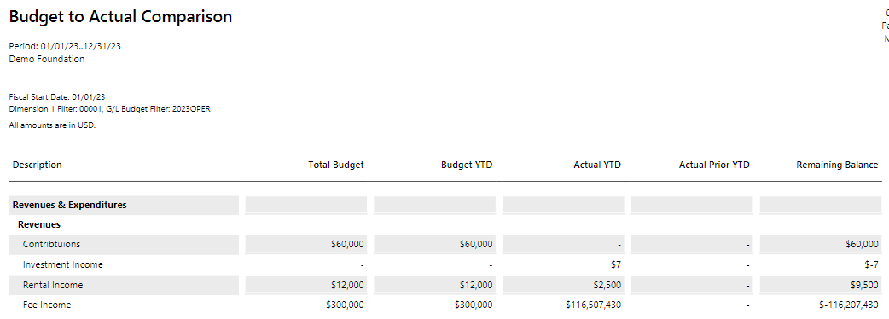
FINANCIAL REPORTS
Customizable row and column sets that can be mixed and matched
Interactive view with drill-down capability
Notes:
Row definitions and column definitions
GL Account Categories
Interactive view
Hiding filters/options
Drill down
Export to Excel

Slide 6
ANALYSIS VIEWS
Analyze Data by Dimensions

Slide 7
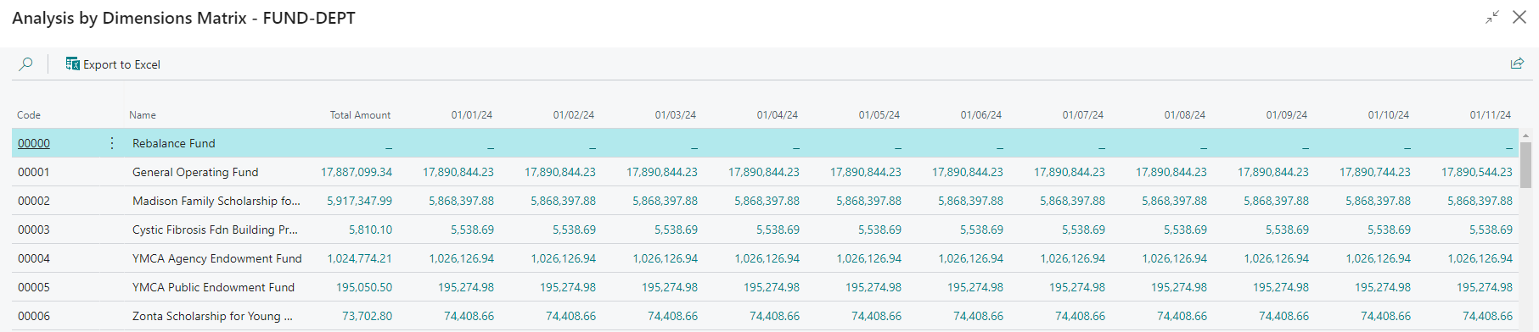
ANALYSIS VIEWS
Summarized data by dimension and GL Account
Source for Analysis by Dimensions matrix
Apply to financial reports to expand filtering capability
Notes:
Existing Analysis Views
Analysis by Dimension (Example: Daily balances by fund, assets only)
Export to Excel (raw data) v. Open in Excel (Matrix View)
Assigning Analysis View to Financial Report
New Dimensions coming soon

Slide 8
ANALYSIS MODE
Create table views to analyze data in Business Central

Slide 9
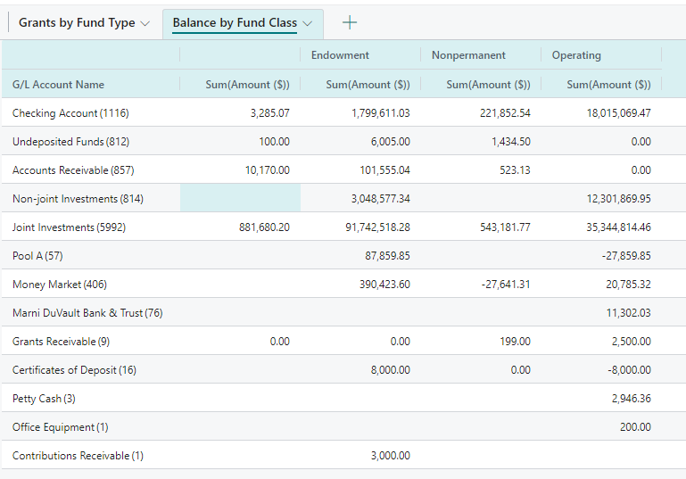
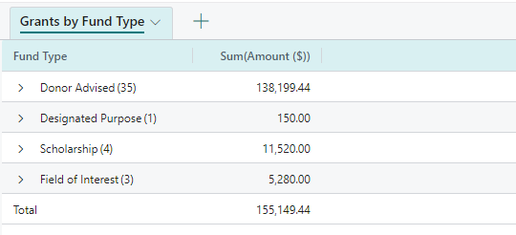
ANALYSIS MODE
Created on lists in Business Central
Table or PivotTable view of data
Notes:
Enter Analysis Mode
Filtering
Edit columns
Regular v. Pivot Mode
Saving/Renaming
Sharing with others

Slide 10
POWER BI
Displaying Power BI dashboards in Business Central

Slide 11
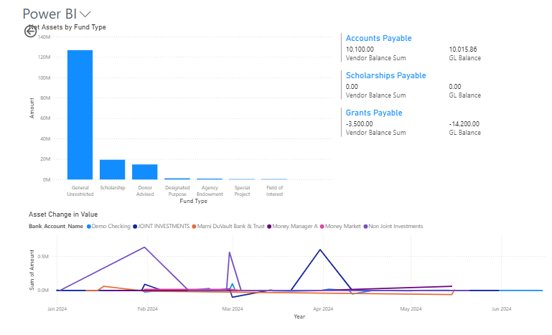
POWER BI
Customizable data visualization
Advanced query capability
Integrate data from other sources
Notes:
Use PowerBI Desktop to design
Data source is Dynamics 365 Business Central
Design/build dashboard report
Save
Publish to a workspace
From BC dashboard, select report
Toggle between reports
Expand to full screen

Slide 12
RESOURCES
Customizing Financial Reports: https://gosupport.powerappsportals.com/knowledgebase/article/KA-01074/en-us
Analysis Views: https://learn.microsoft.com/en-us/dynamics365/business-central/bi-how-analyze-data-dimension
Analysis Mode: https://learn.microsoft.com/en-us/dynamics365/business-central/analysis-mode#get-started
Excel Reports: https://learn.microsoft.com/en-us/dynamics365/business-central/ui-excel-report-layouts?tabs=any-report
Power BI:
https://learn.microsoft.com/en-us/dynamics365/business-central/admin-powerbi
https://learn.microsoft.com/en-us/training/modules/get-started-with-power-bi/

Slide 13
PRESENTED BY
Meghan Davignon
Director of Product
THANK YOU

