Slide 1



Share your photos to
the conference album!
#EMPOWERED2024

Slide 3
GOapply SCHOLARSHIP PROCESS
PRESENTED BY
Tyler Long | Manager of Technical Services
Marni DuVal | Agile Coach

Slide 4

EXISTING SCHOLARSHIP
FUNCTIONS
What’s here NOW?

Slide 5
KEY FEATURES AND BENEFITS: THIRD-PARTY RESPONSES
Feature | Example | Benefit
Allows the student to send forms to be completed by a third party (usually a school or a reference) | Request an accurate and up to date transcript directly from the registrar's office. | Allow for more efficient recommendations, accurate documents, and a self-serve student process.

Slide 6
THIRD-PARTY RESPONSES
Transcripts and Recommendations

Slide 7
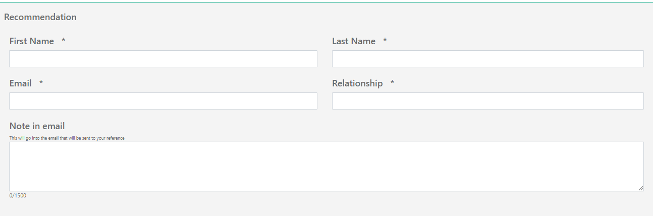
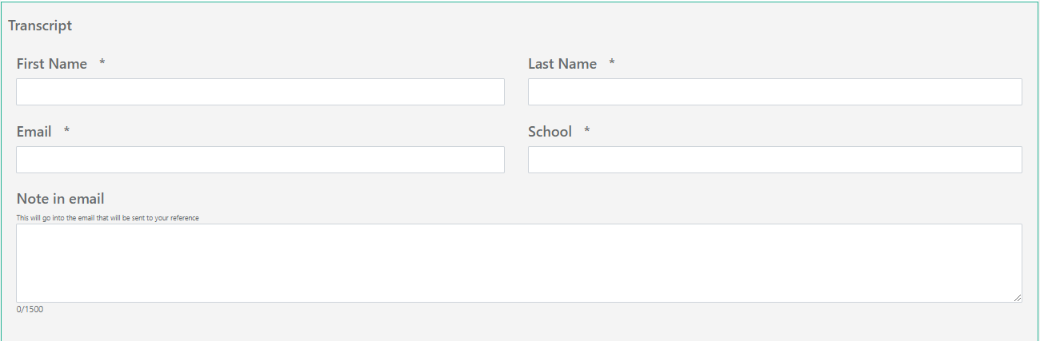
APPLICATION PHASE
PRE-MAPPED PANELS

Slide 8
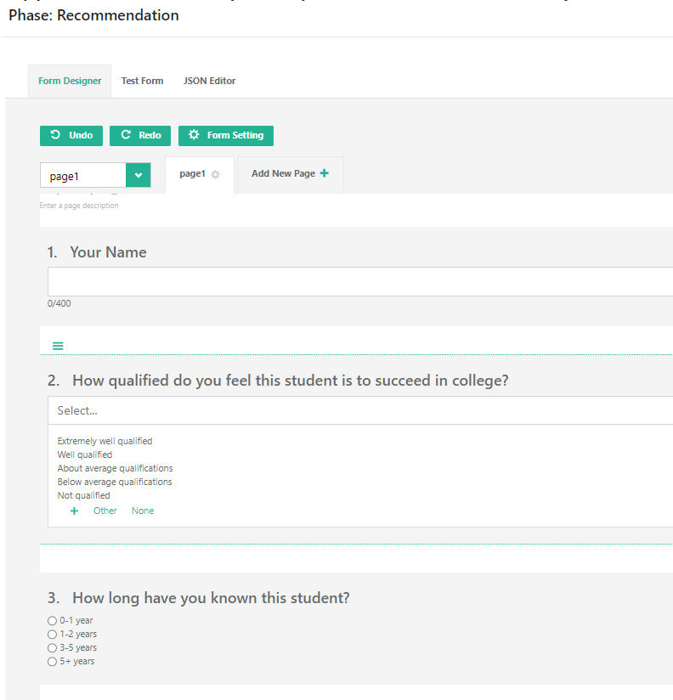
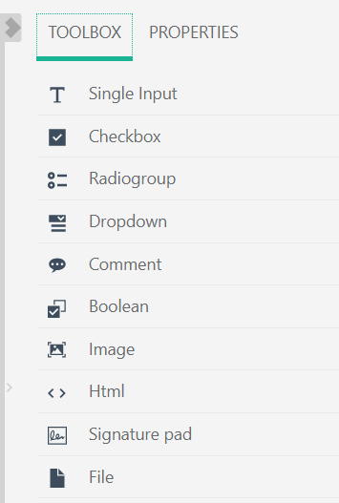
RECOMMENDATIONS FORM BUILDER

Slide 9
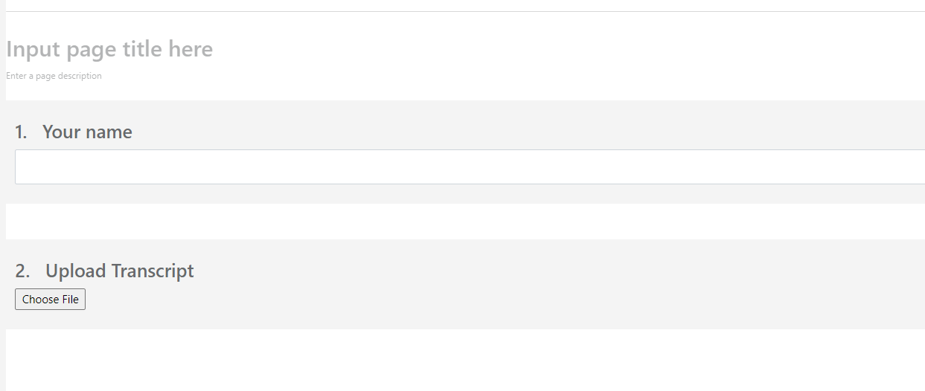
TRANSCRIPTS FORM BUILDER

Slide 10
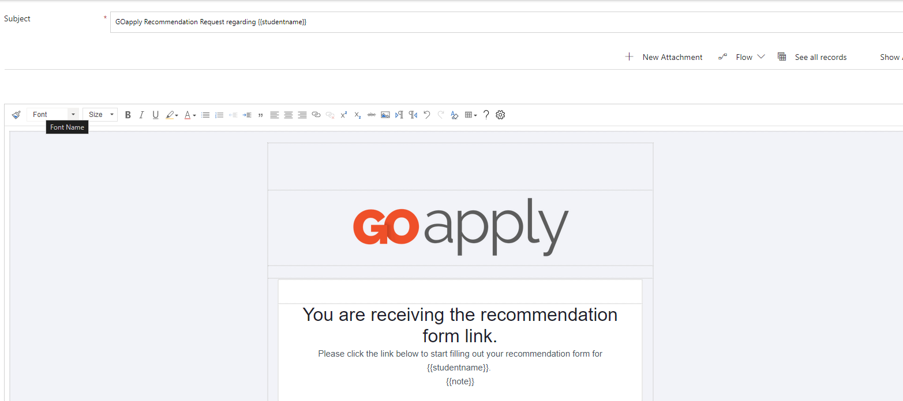
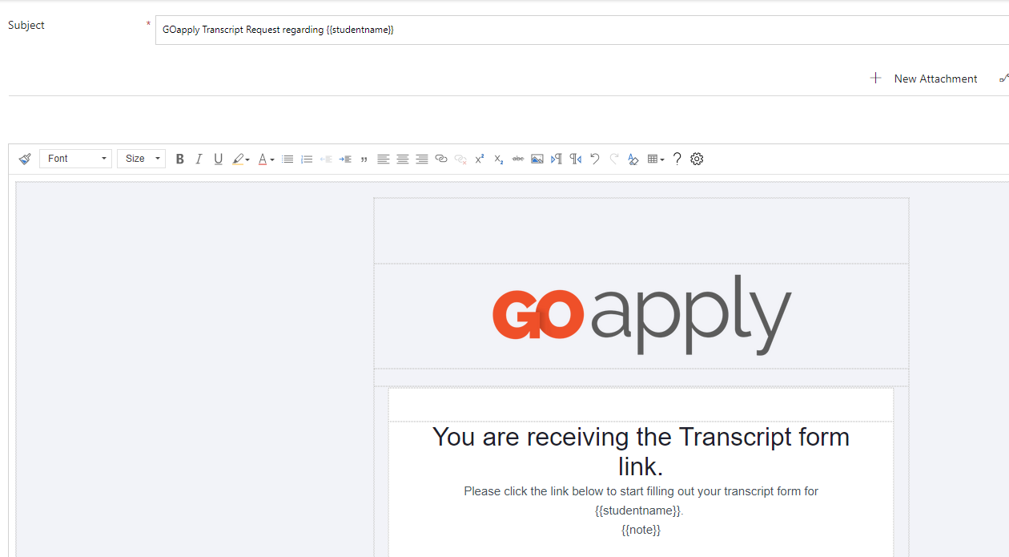
TEMPLATES FOR THIRD-PARTY RESPONSES

Slide 11
KEY FEATURES AND BENEFITS: SCHOLARSHIP PHASES
Feature | Example | Benefit
Separate phases to manage the life cycle of the request | Scholarship acceptance phase post award. Scholarship renewal phases as needed for renewable scholarships. | Track scholarship requirements automatically for easier follow up with missing students.

Slide 12
PHASES WITH
2-WAY MAPPING
Show award information in 2nd phase.

Slide 13
WHAT IS IT?
If the GOapply Status Tracking record contains a request, mapped fields will display data!
How it works:
    Read-only fields: Two-way mapping will update each time the user opens the form.
    Editable fields: Two-way mapping will update ONCE when the user opens the form for the first time.

Slide 14
WAYS TO IMPLEMENT
Scholarship acceptance phase
      Show the scholarship name
      Show the payment amount
Schedule out requirements for each semester and follow up with the requirement received date and requirement due date

Slide 15
PEER PRESENTER: SCHOLARSHIP REVIEW PDFS
Create Custom review documents for your reviewers

Slide 16
Key Features and Benefits: Custom Review File
Feature | Example | Benefit
Power automate flow to populate a template with student responses | Exempt data from the doc to ensure anonymity | Not bound to the out of the box review form

Slide 17
COMING SOON:
STREAMLINED SCHOLARSHIP PROCESSING
Auto assign requested scholarship based on criteria

Slide 18
KEY FEATURES AND BENEFITS: SCHOLARSHIP AUTO-MATCHING
Feature | Example | Benefit
Process to assign requested scholarship based on a set of scholarship criteria | A general scholarship application that determines eligibility for all scholarships based on responses. | Reduce errors in determining eligibility, streamline eligibility screening, easier distribution to review groups and no student error.

Slide 19
THINGS TO KNOW
ALL criteria fields MUST BE MAPPED
    Auto-matching is an akoyaGO process, it happens with the REQUEST
Auto-matching is enabled on the GOapply Opportunity
Criteria are managed in the Scholarship entity

Slide 20
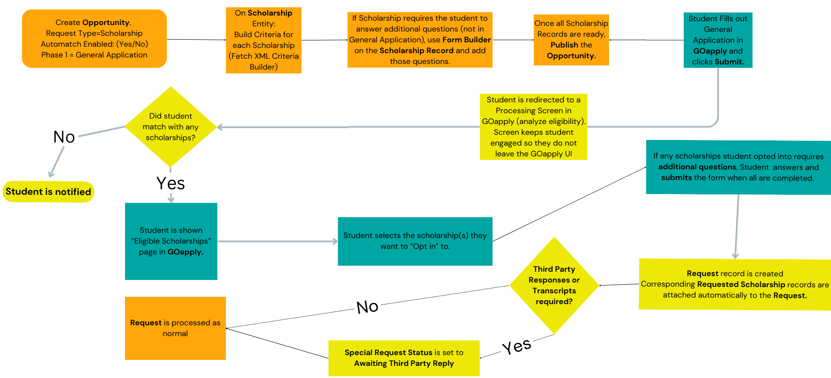
SCHOLARSHIP WORKFLOW
Notes:
Canva link to edit: https://www.canva.com/design/DAGKqq_FcRs/45DEXtlOkuHwFVH-C8qCzg/edit?utm_content=DAGKqq_FcRs&utm_campaign=designshare&utm_medium=link2&utm_source=sharebutton

Slide 21
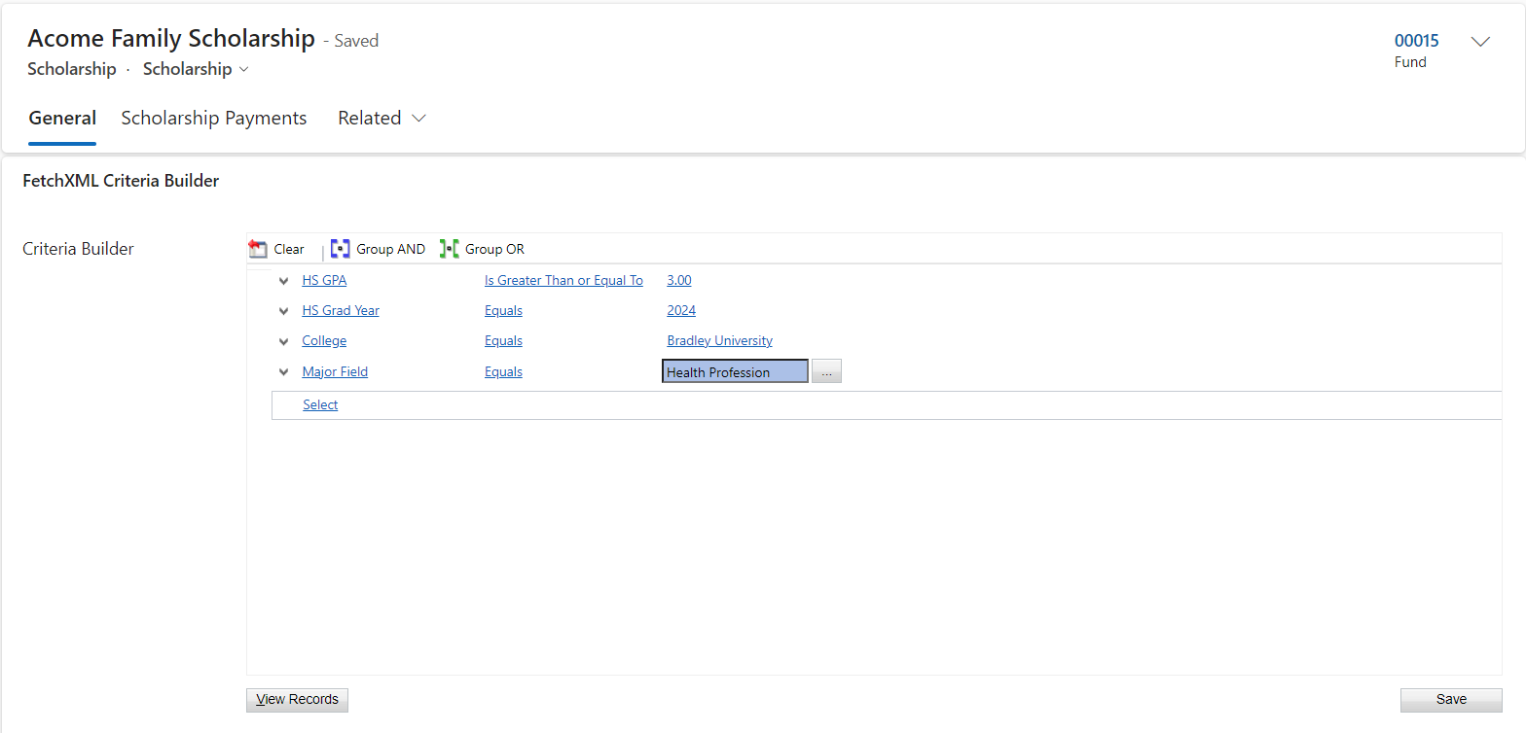
CRITERIA BUILDER SNEAK PEEK

Slide 22
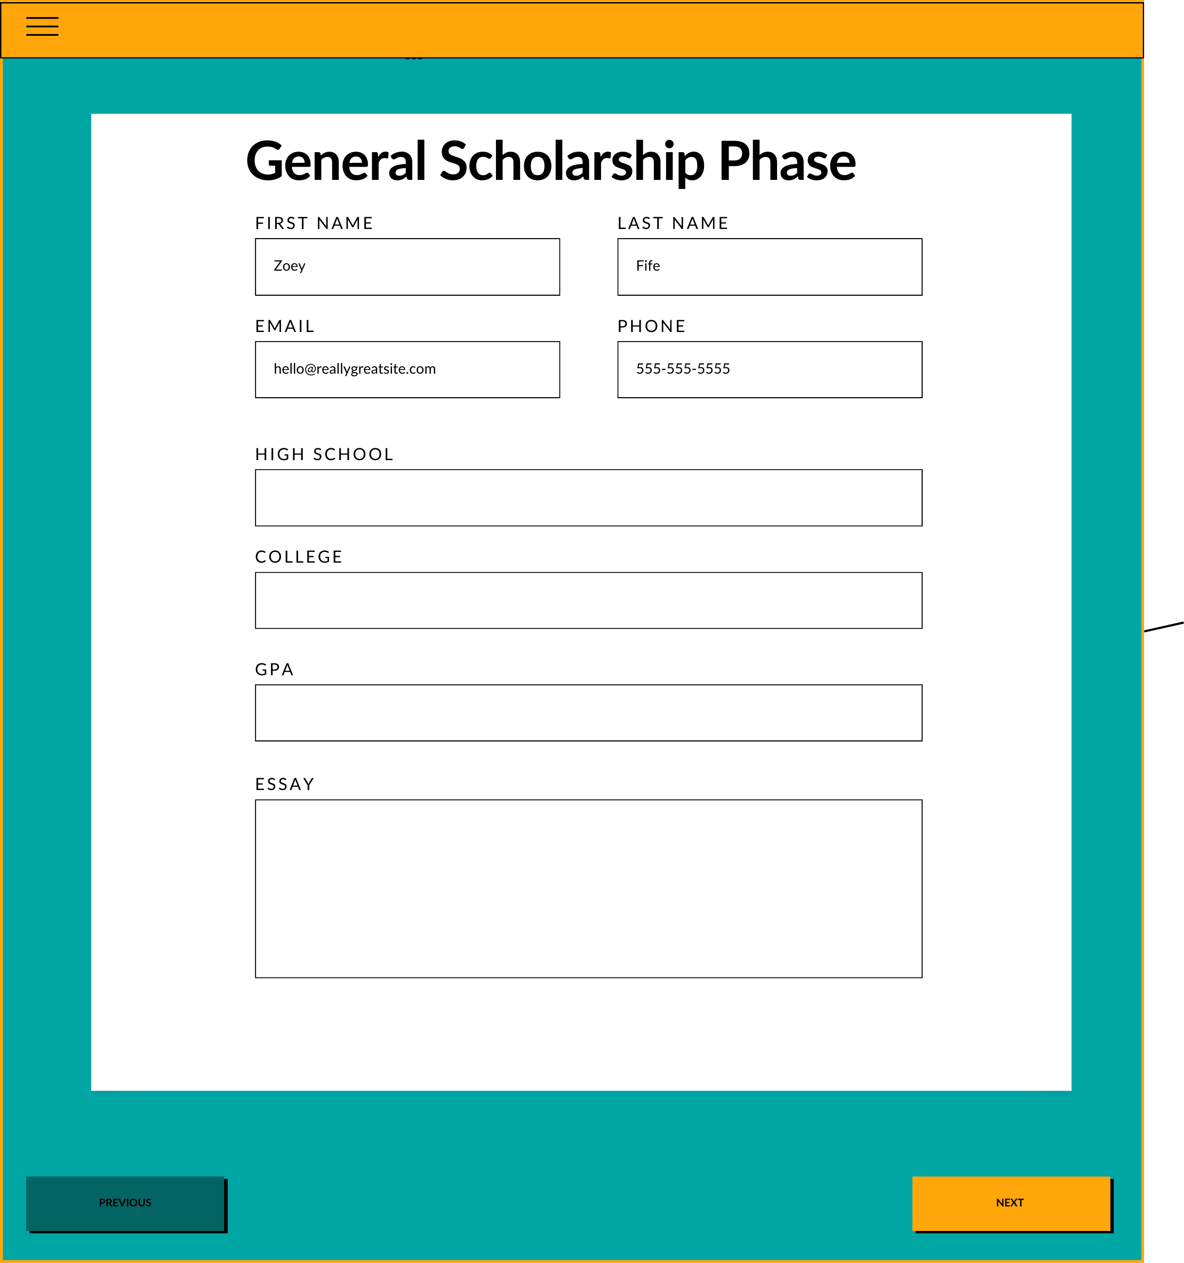
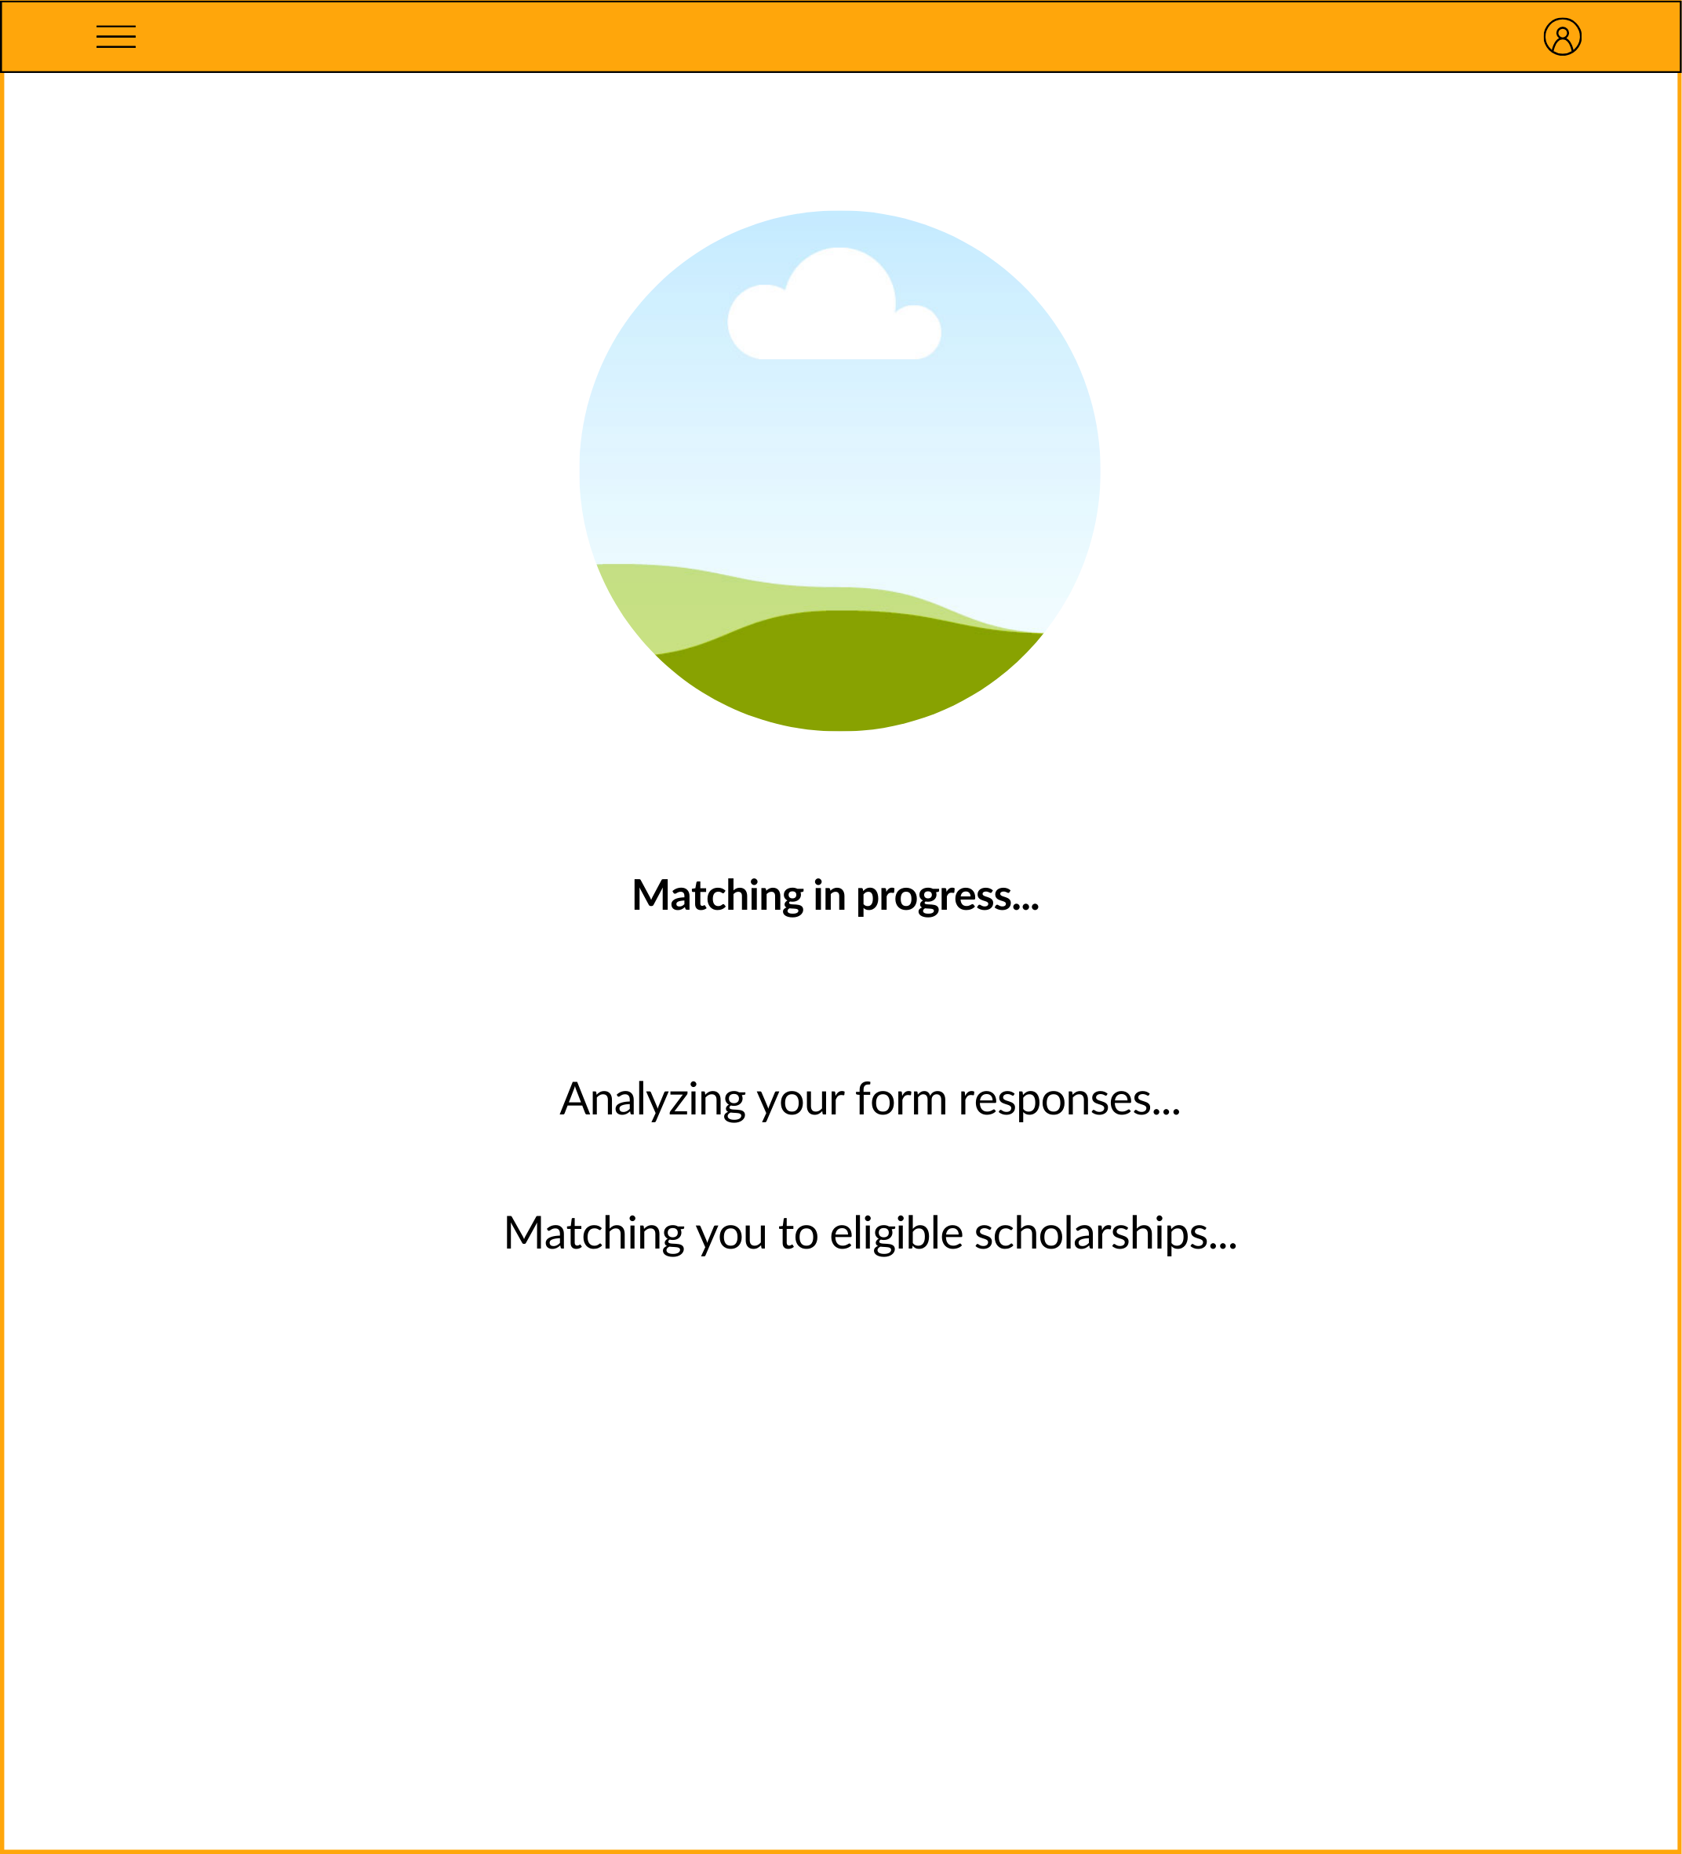

Slide 23
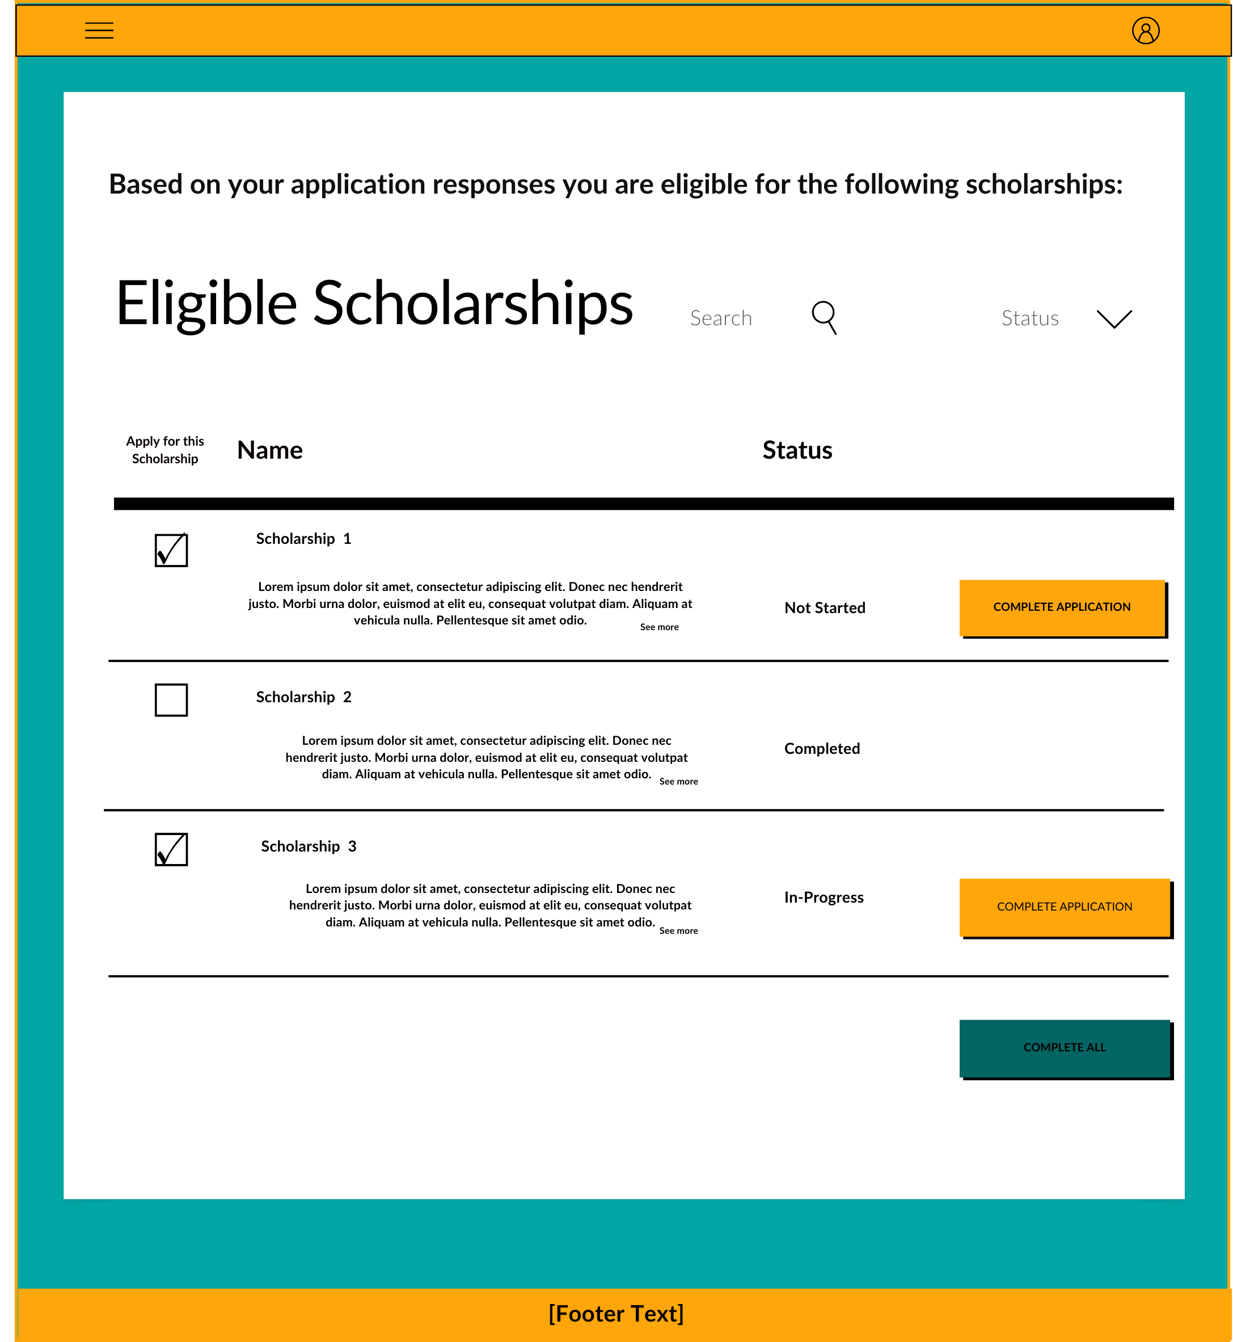
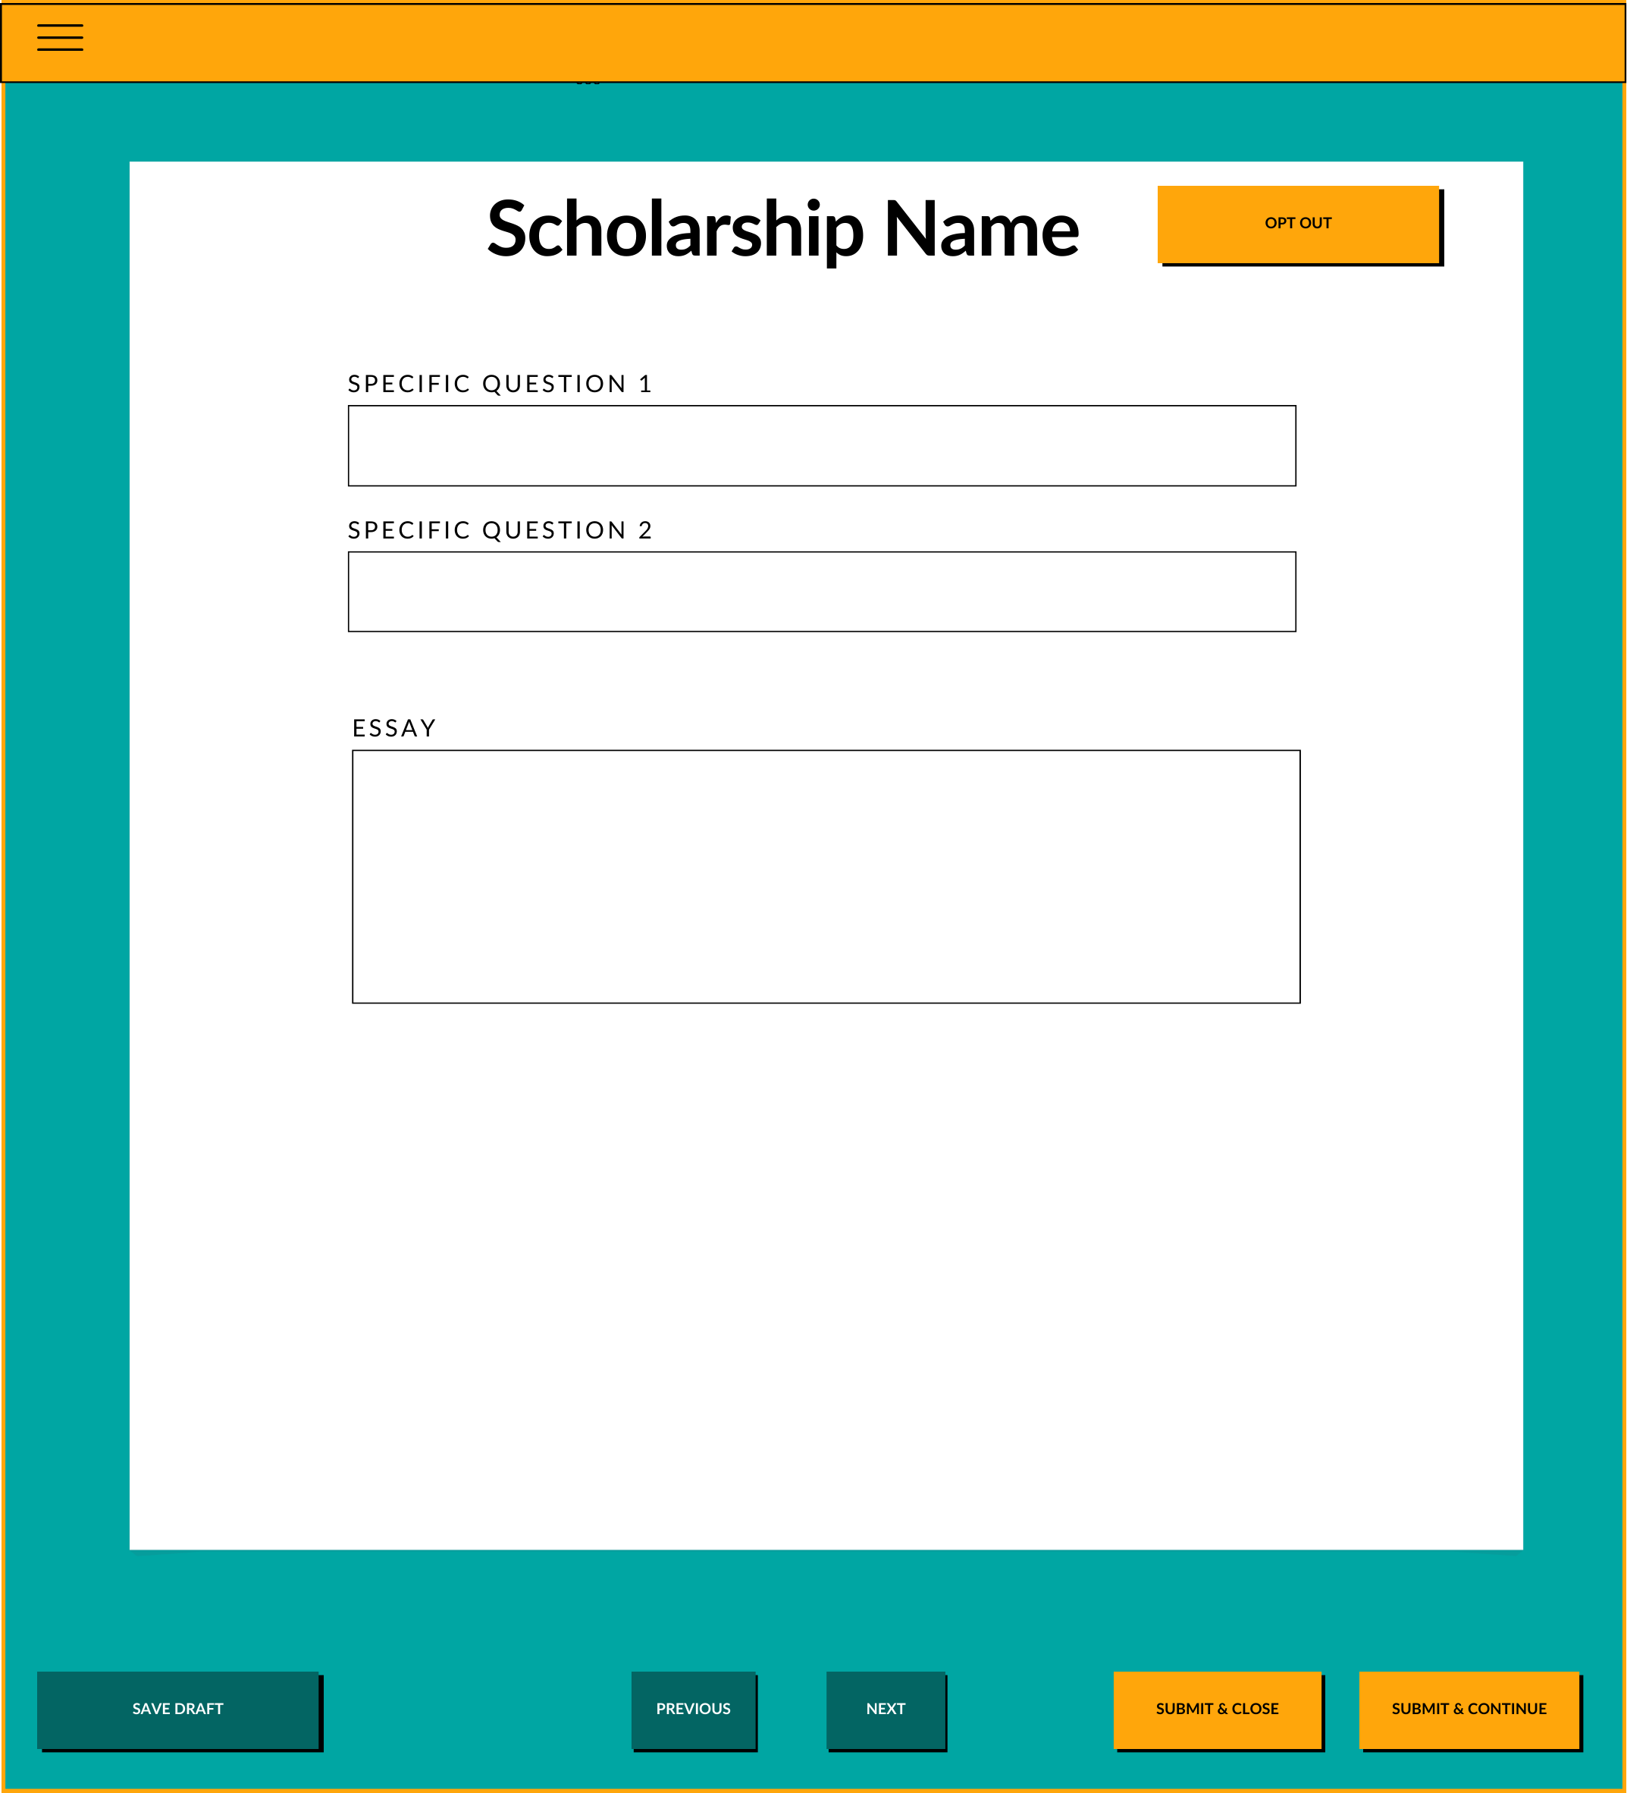

Slide 24
PRESENTED BY
Marni DuVal
Agile Coach
Tyler Long
Manager of Technical Services
THANK YOU

