Slide 1



Share your photos to
the conference album!
#EMPOWERED2024

Slide 3
GOapply NEW FEATURES
PRESENTED BY
Zoey Fife | Support Tech Tier III

Slide 4

MULTI-SITE SETUP
Have up to 3 different GOapply sites!

Slide 5
MULTI-SITE SETUP
Why: geographic affiliates, unique branding, different use cases, scholarships vs. awards
How:
  Contact akoyaGO support so we can update our records
  Create a 2nd (or 3rd) GOapply Settings record with your new site details
  Create applications and phases and use the new GOapply settings

Slide 6
NEW PRE-FORMATTED FIELDS
Make your user experience more seamless

Slide 7
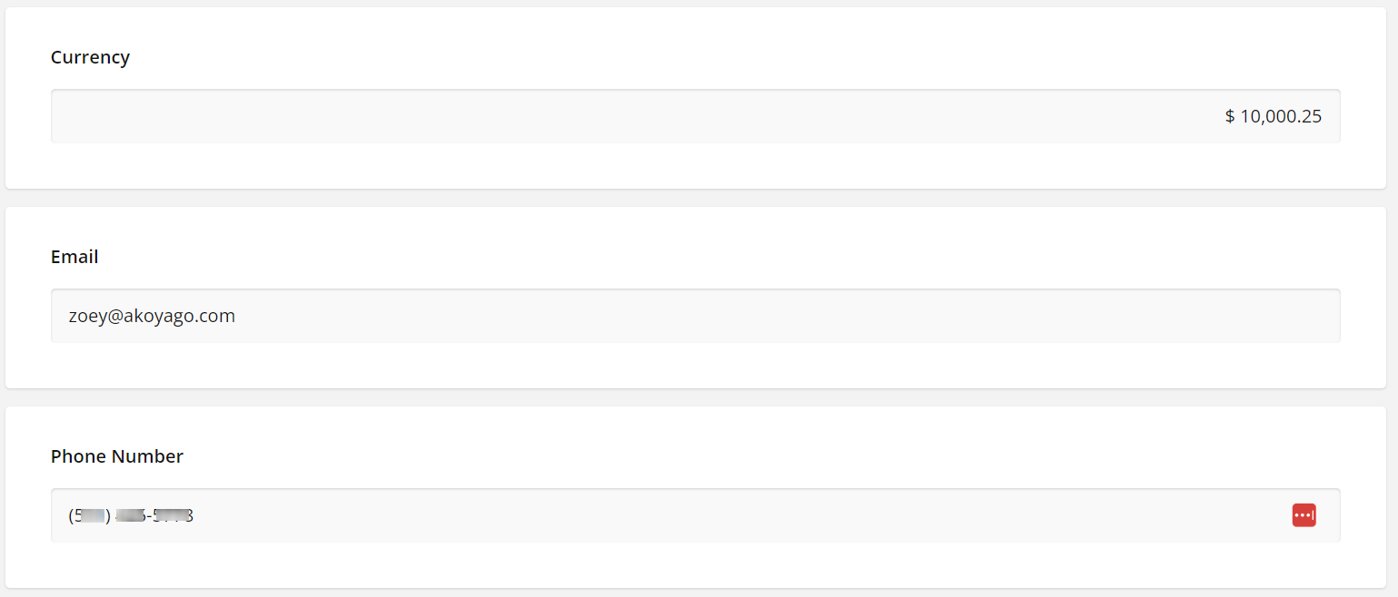
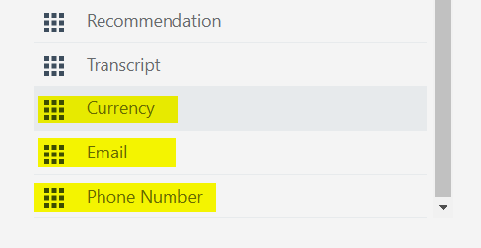
PRE-FORMATTED FIELDS

Slide 8
BULK IMPORT USERS
New improvements to reduce time spent on importing users!

Slide 9
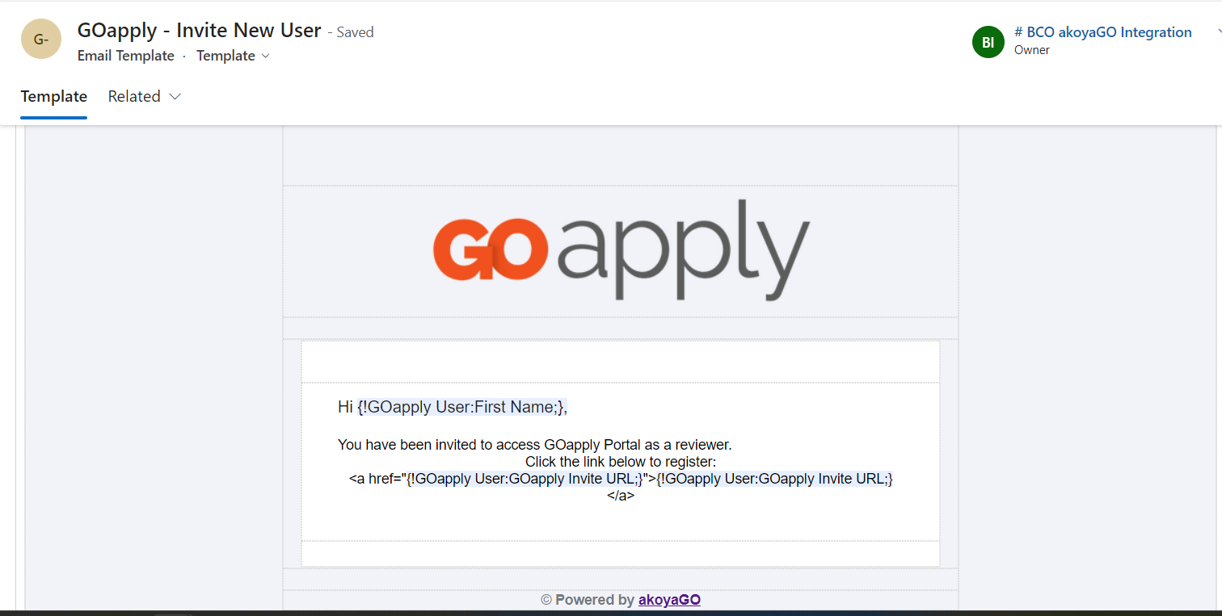
BULK IMPORT USERS
Import reviewers or applicants
Uses the “GOapply Invite New User” email template, and updates the language as necessary.

Slide 10
CHOICE QUESTION MAPPING
New improvements to avoid issues with choices!

Slide 11
CHOICE QUESTIONS AUTO POPULATE
If a choice question is mapped, you can now save the form editor and choices will be automatically added!

Slide 12
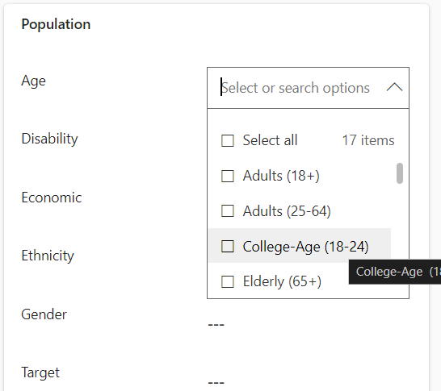
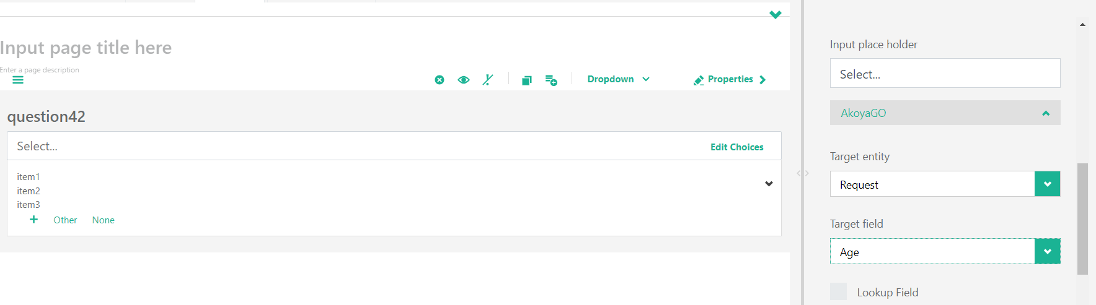
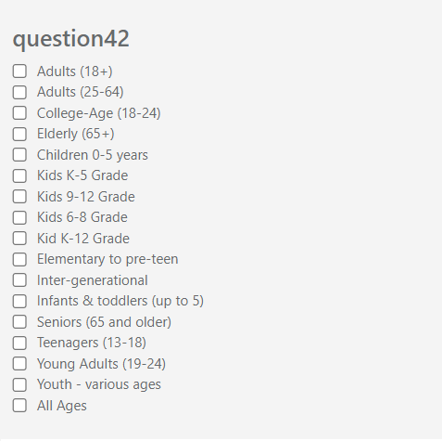
CHOICE QUESTION EXAMPLE
Request Field
Before Save
After Save

Slide 13
CUSTOMIZATION OPTIONS
New options for registration customization

Slide 14
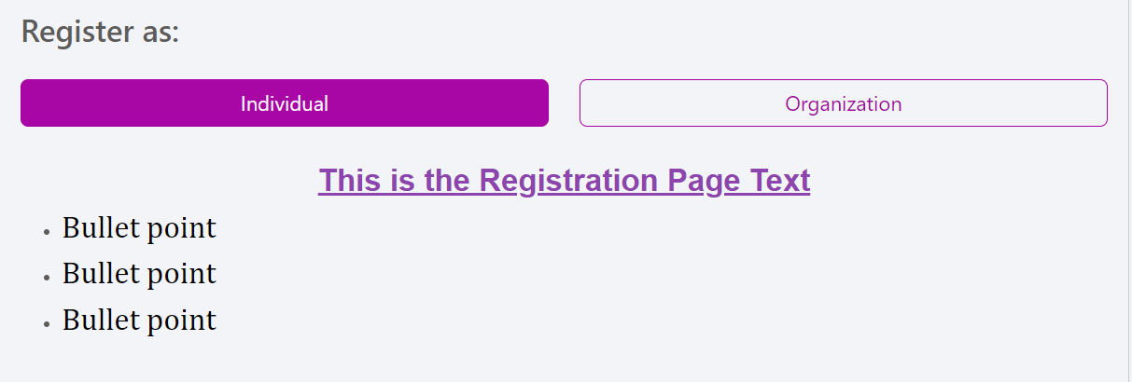
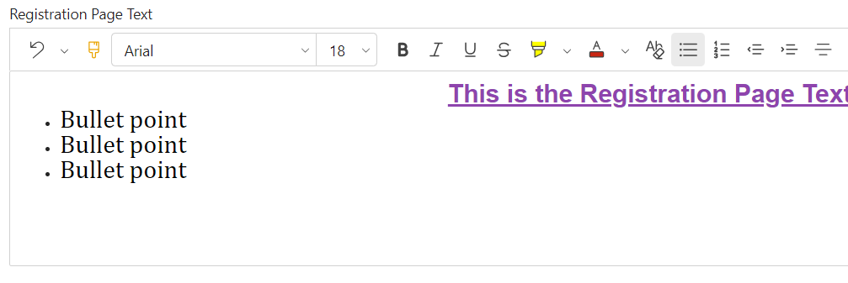
REGISTRATION PAGE TEXT

Slide 15
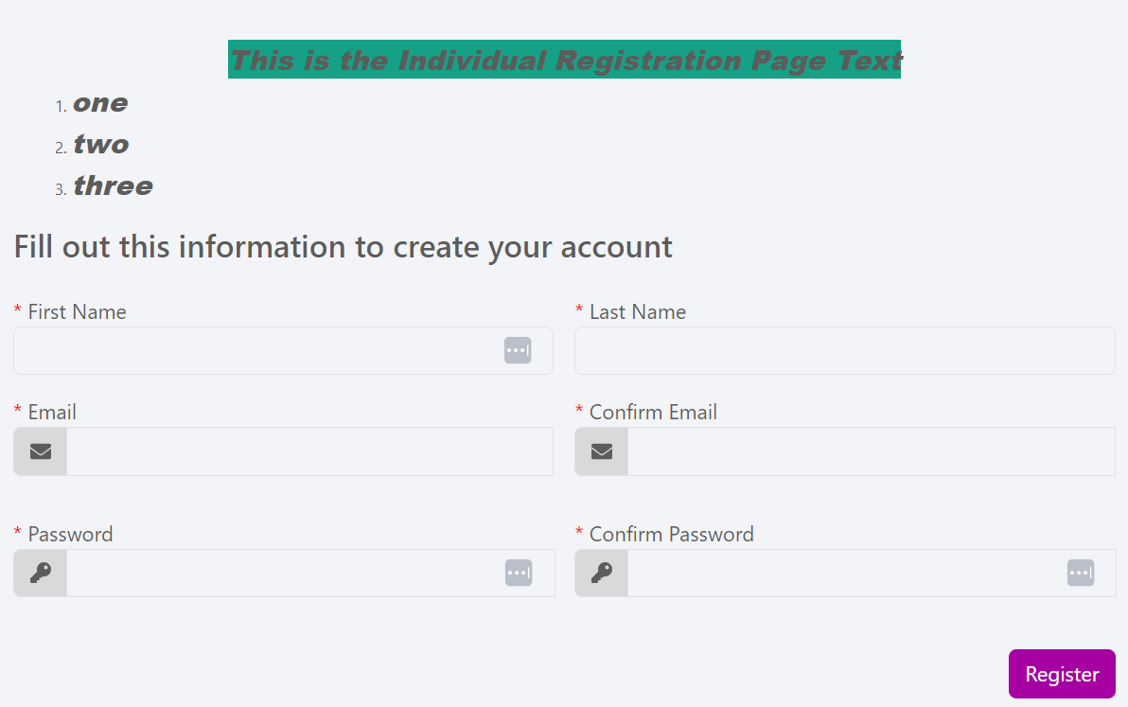
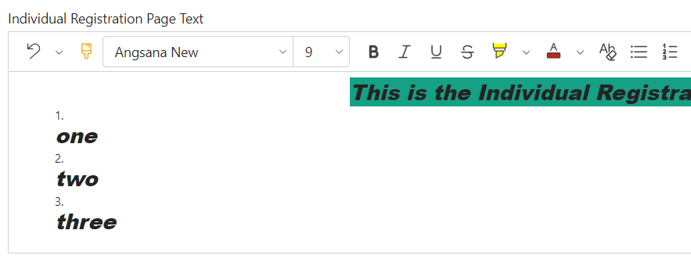
INDIVIDUAL REGISTRATION PAGE

Slide 16
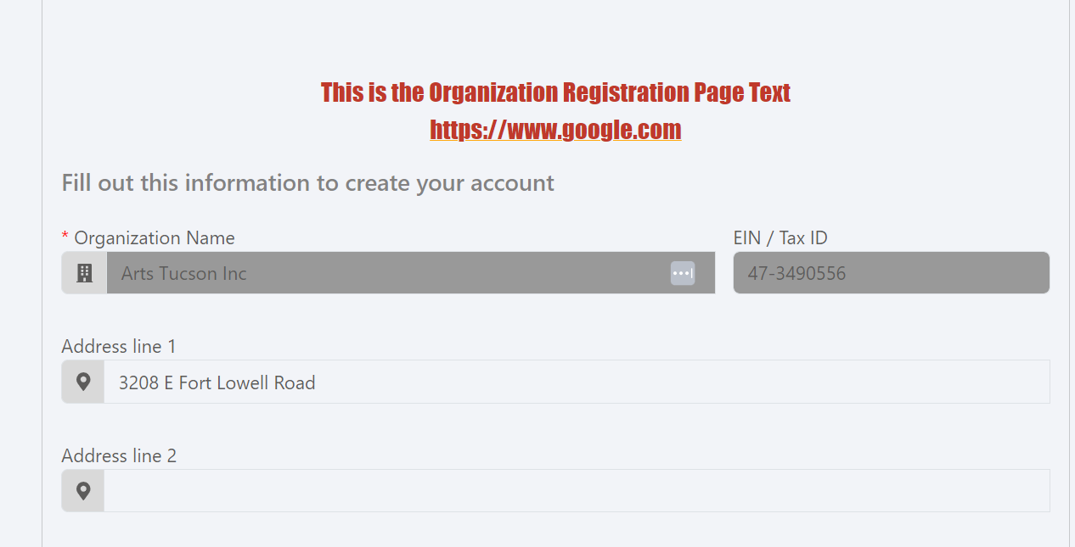
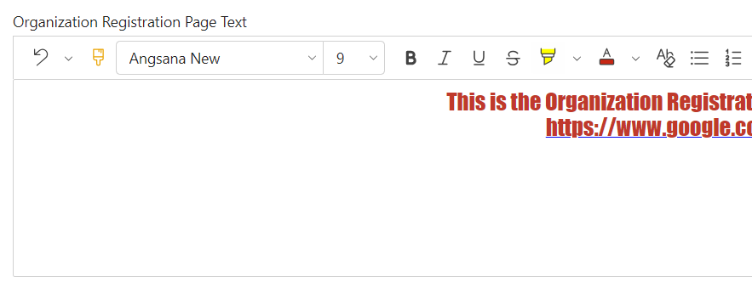
ORGANIZATION REGISTRATION PAGE
Note: This text appears AFTER the tax ID/ organization name search

Slide 17
COMING SOON
Scholarship auto-matching for eligibility
Simplified form builder- no more mapping!
Reviewer improvements

Slide 18
PRESENTED BY
Zoey Fife
Support Tech Tier III
THANK YOU

